Slide 1
A* Search

Slide 2
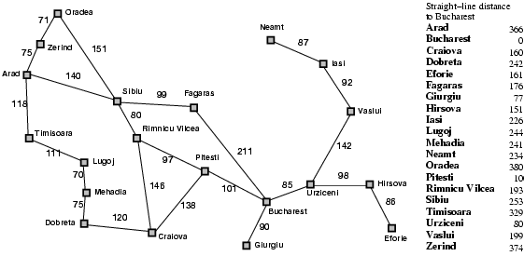
Start Node
Goal Node

Slide 3
Dijkstra’s Algorithm
Start Node
Traversing too many nodes
Goal Node

Slide 4
Dijkstra’s Algorithm
Dijkstra’s algorithm has one cost function, which is real cost value from source to each node:
f(n)=g(n).

Slide 5
IDEA!!!
Use heuristics to guide the search.
Heuristic: estimation of how to search for a solution
Evaluation function f(n) = g(n) + h(n) where
g(n) = cost so far to reach n
h(n) = estimated cost from n to goal
f(n) = estimated total cost of path through n to goal

Slide 6
A* Search
Start Node
Goal Node
100

Slide 7
A* Search
Zerind: f(n) = g(n) + h(n) = 75 + 374 = 449
Timisoara: f(n) = g(n) + h(n) = 118 + 329 = 447
Sibiu: f(n) = g(n) + h(n) = 140 + 253 = 393
100

Slide 8
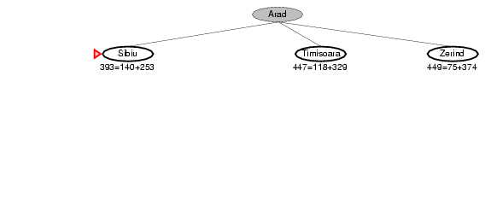
A* Search

Slide 9
A* Search
Fagaras : f(n) = g(n) + h(n) = (140+99) + 176 = 415
Rimnicu Vilcea : f(n) = g(n) + h(n) = (140+80) + 193 = 413
Oradea : f(n) = g(n) + h(n) = (140+151) + 380 = 671
100

Slide 10
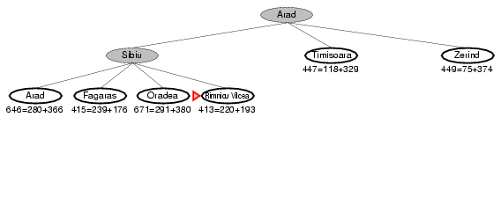
A* Search

Slide 11
A* Search
Fagaras : f(n) = g(n) + h(n) = (140+99) + 176 = 415
Pitesti : f(n) = g(n) + h(n) = (140+80+97) + 100 = 417
100

Slide 12
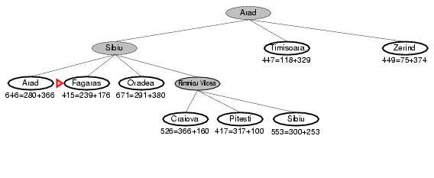
A* Search

Slide 13
A* Search
Fagaras : f(n) = g(n) + h(n) = (140+99) + 176 = 415
Pitesti : f(n) = g(n) + h(n) = (140+80+97) + 100 = 417
Bucharest (via fagaras) : f(n) = g(n) + h(n) = (140+99+211) + 0 = 450
100

Slide 14
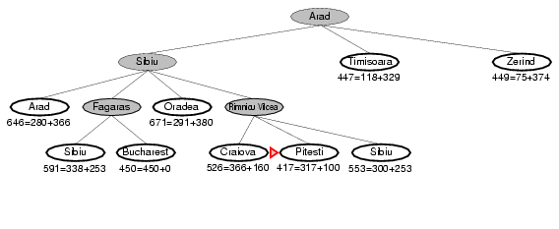
A* Search

Slide 15
A* Search
Fagaras : f(n) = g(n) + h(n) = (140+99) + 176 = 415
Pitesti : f(n) = g(n) + h(n) = (140+80+97) + 100 = 417
Bucharest (via fagaras) : f(n) = g(n) + h(n) = (140+99+211) + 0 = 450
Bucharest (via Pitesti) : f(n) = g(n) + h(n) = (140+80+97+101) + 0 = 418
100

Slide 16
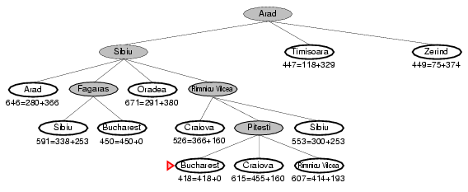
A* Search

Slide 17
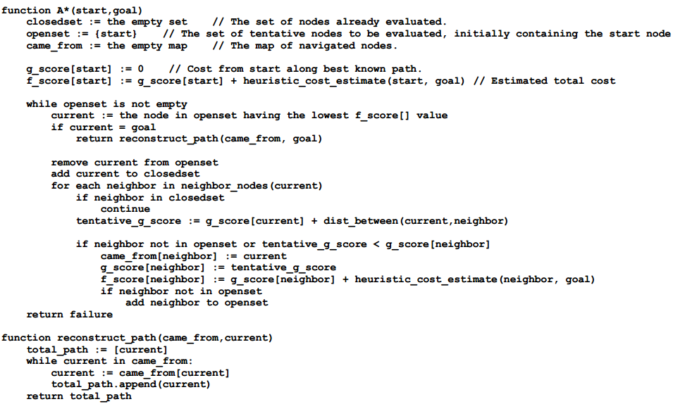
A* Search

Slide 18
A* Search
When h(n) = actual cost to goal
Only nodes in the correct path are expanded
Optimal solution is found
When h(n) < actual cost to goal
Additional nodes are expanded
Optimal solution is found
When h(n) > actual cost to goal
Optimal solution can be overlooked

Slide 19
Admissible heuristics
A heuristic h(n) is admissible if for every node n, h(n) ≤ h*(n), where h*(n) is the true cost to reach the goal state from n.
An admissible heuristic never overestimates the cost to reach the goal, i.e., it is optimistic.
If h(n) is admissible, A* using TREE-SEARCH is optimal

Slide 20
Dominance
If h₂(n) ≥ h₁(n) for all n (both admissible)
then h₂ dominates h₁
h₂ is better for search: it is guaranteed to expand less or equal number of nodes.

Slide 21
Consistent heuristics
h(n) is consistent if for every node n and for every successor node n’ of n:
h(n) ≤ c(n, n’) + h(n’)
h(n)
n
d
c(n,n’)
h(n’)
n’

Slide 22
Consistent heuristics
If h(n) is consistent then h(n) is admissible
Frequently when h(n) is admissible, it is also consistent.
If h(n) is a consistent heuristic, A* using graph search is optimal.

Slide 23
Consistent heuristics
H is admissible but not consistent heuristic
Graph search will find path a-c-d.
c will be expanded after a, and there will be
no option to expand c again after expanding b
(Since c already in closed set)
h(a)=12
h(b)=11
1
a
b
1
3
c
10
d
h(c)=0
h(d)=0

Slide 24
THANK YOU!!!

